Slide 1
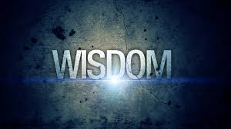

Slide 2
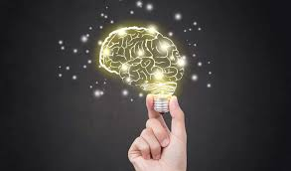

Wisdom is the product of
knowledge and experience,
but it is more than the
accumulation of information.
It is the coordination of this information and its deliberate use to improve well-being.
In a social context, wisdom allows
the individual to listen to others,
to evaluate what they say, and then
offer them good advice.

Slide 3
In recent psychological history, two major research groups stand out as major contributors to the scientific study of wisdom:
  Paul Baltes and his colleagues at the Max Planck Institue for Human Development in Berlin and
  Robert Sternberg and his colleagues at Yale University.
There is much overlap between the way the two groups theorize wisdom and their research findings are often complementary.

Slide 4
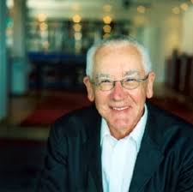
Baltes and colleagues define wisdom as expertise in the conduct and meaning of life.
According to their theory, a wise person is someone who knows what is most important in life and how to get it.
He or she knows what constitutes the meaningful life and how to plan for and manage such a life (Baltes & Staudinger, 2000).

